Slide 1
ALL and ALLEXPECT and ALLSELETED
ALL and ALLEXPECT and ALLSELETED

Slide 2
ALL and ALLEXPECT and ALLSELECTED
Note: This demo uses two tables created directly in Power BI for simplicity
ID | Name | Color | Size
1 | Product1 | Green | Little
2 | Product2 | Blue | Little
3 | Product3 | Blue | Little
4 | Product1 | Blue | Little
5 | Product2 | Blue | Little
6 | Product3 | Blue | AVERAGE
7 | Product1 | Blue | AVERAGE
8 | Product2 | Blue | Big
9 | Product3 | Blue | Big
10 | Product1 | Red | Big
11 | Product2 | Red | Big
12 | Product3 | Red | Big
ID | Sales
1 | 10
2 | 30
3 | 20
4 | 10
5 | 10
6 | 10
7 | 20
8 | 25
9 | 15
10 | 10
11 | 25
12 | 30

Slide 3
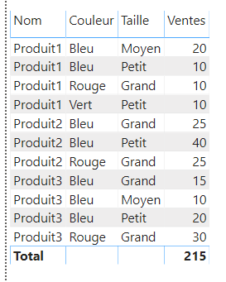
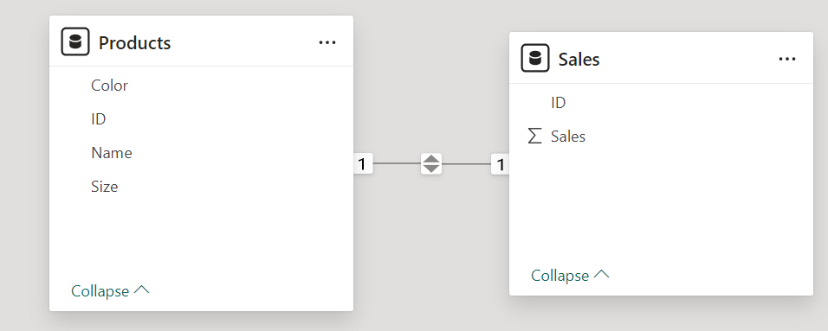
ALL and ALLEXPECT and ALLSELECTED
Add a relationship between the two tables based on the ID column of the both sides
Add a Table visualization to the scene with the characteristics of the products Name , Color and Size with the sum of sales as aggregation

Slide 4
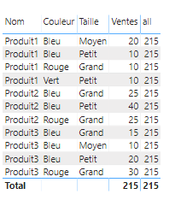
ALL and ALLEXPECT and ALLSELECTED
Add a measure named all to the FactProduct table with the formula
all = CALCULATE(SUM(FactProduit[Ventes]), ALL(DimProduit))
Add measure to visualization
Note that the all measure shows the same result as Total and that it eliminates the filter throughout the operation of calculating the sum of sales

Slide 5
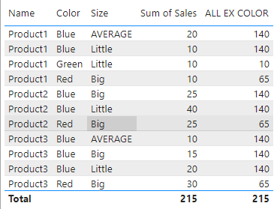
ALL and ALLEXPECT and ALLSELECTED
Create a new measure with the name and ALL EX COLOR which cancels the application of the filter except for the color
ALL EX COLOR = CALCULATE(SUM(Sales[Sales]), ALLEXCEPT(Products, Products[Color]))
Blue = 20 + 10 +25 + 40 + 10 +15 + 20
Green = 10
Red = 10 + 25 + 30

Slide 6
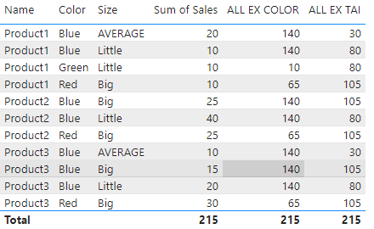
ALL and ALLEXPECT and ALLSELECTED
Create ALL EX SIZE measure that cancels the filter except for the size criterion
ALL EX SIZE = CALCULATE(SUM(Sales[Sales]), ALLEXCEPT(Products, Products[Size]))

Slide 7
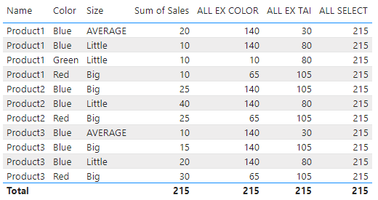
ALL and ALLEXPECT and ALLSELECTED
Add the measure to the visualization instead of ALL SELECT and note that it cancels the filter on sum operations except on the size criterion
ALL SELECT = CALCULATE(SUM(Sales[Sales]), ALLSELECTED(Products))

Slide 8
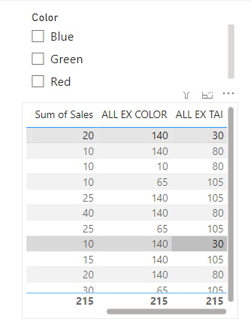
ALL and ALLEXPECT and ALLSELECTED
Add a Slicer visualization to the scene configure it to list the colors

Slide 9
Thank you
Thank you

